Slide 1
MCA Major Project
Analyzing the Impact of Digital Learning on Rural Education
Student Name: Anjali Kundliya
Specialization: MCA-Data Analytics
College Name: Chandigarh University
Academic Year: 2024-25

Slide 2
Introduction
India has made significant progress in education, but rural areas still face challenges in access and quality
The rise of digital learning tools has created new opportunities for improving rural education
This study aligns with Sustainable Development Goal 4 (SDG 4): Quality Education—ensuring inclusive and equitable education for all

Slide 3
Problem Statement & Objective
Problem
Objective
To analyze the impact of digital learning on rural education using real datasets and build an interactive dashboard
To identify gaps and provide actionable insights for policy-makers and stakeholders
Rural regions face poor internet access, low digital literacy, and unequal educational outcomes—especially for girls

Slide 4
Tools & Technologies Used
Google Colab (Python)
MYSQL
Power BI
Data cleaning, merging, preprocessing
Centralized database for storing cleaned dataset
Used for creating interactive charts and dashboards
Data Sources
(Kaggle)
Education in India, Internet usage Rural vs Urban, Literacy Rate, 2011 Census of India

Slide 5
Power BI Dashboard

Slide 6
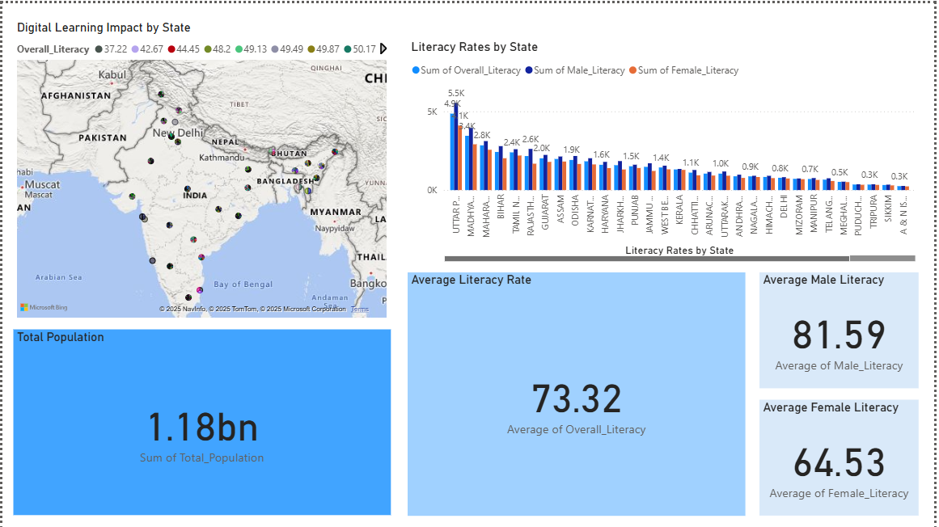
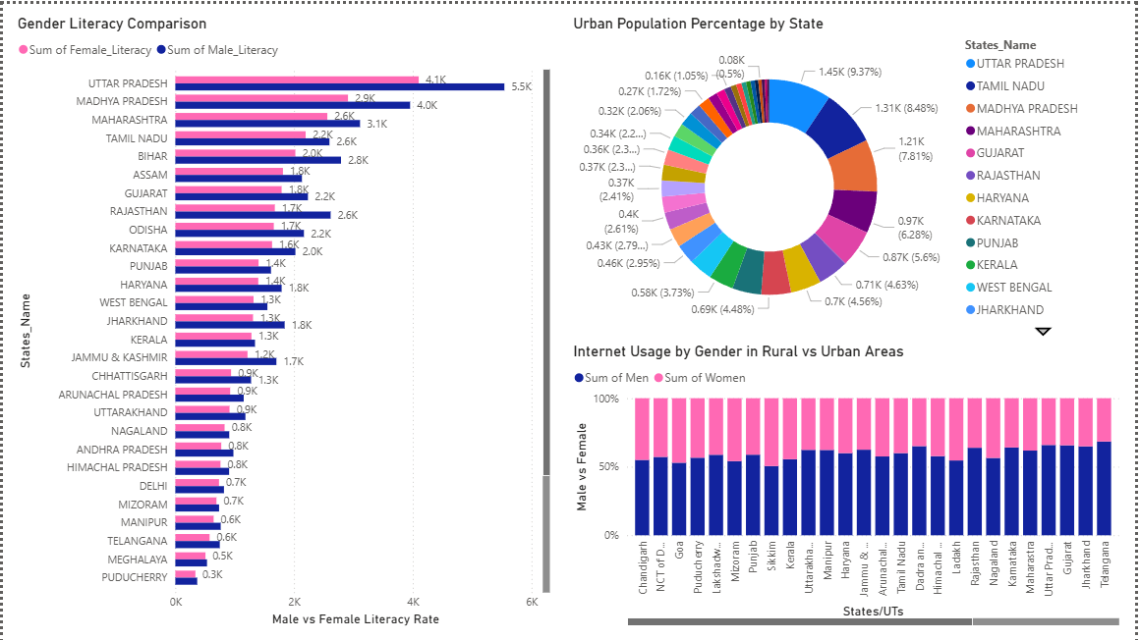
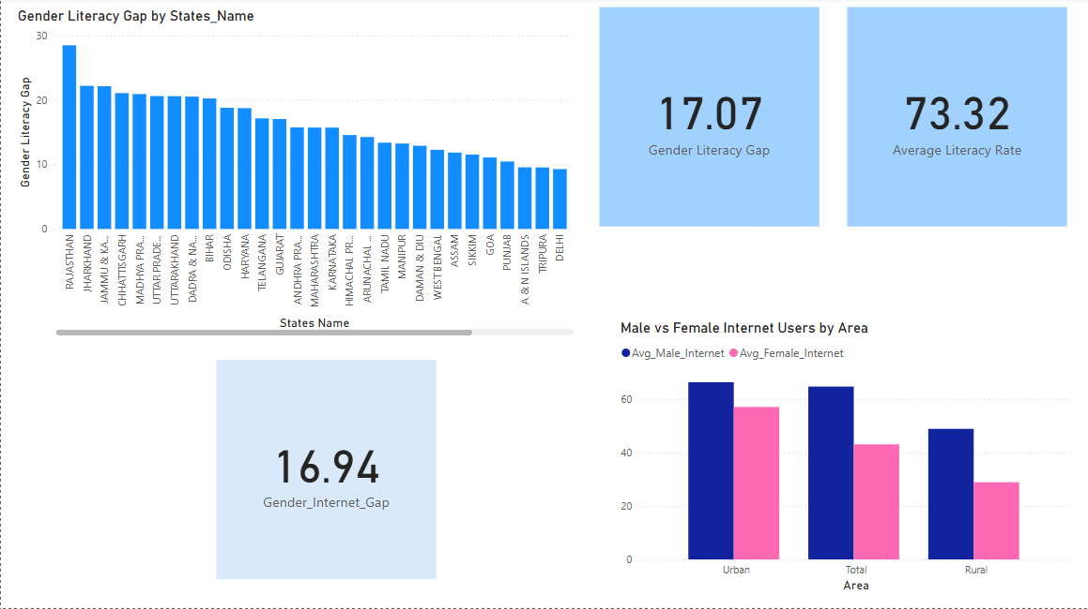

Slide 7
Key Insights
Insight 1
Insight 2
Insight 3
States with better internet access show higher literacy and enrollment
Gender disparity in internet usage is higher in rural areas
Need for targeted interventions in underdeveloped districts

Slide 8
Conclusion & Recommendations
Digital learning has significant potential to improve rural education
Infrastructure development (broadband, devices) is crucial
Training for teachers on using tech tools must be prioritized
Suggest integrating real-time monitoring dashboards for future projects

Slide 9
Thank you for your attention!
Project GitHub Link

